Slide 1
WildLife Rescue Centre
Presentation by:
Wahid Hoji Aminullah
Mohamed Elmuzamil Hassan
Maather Al Rawahi
Mohammed Elsayed

Slide 2
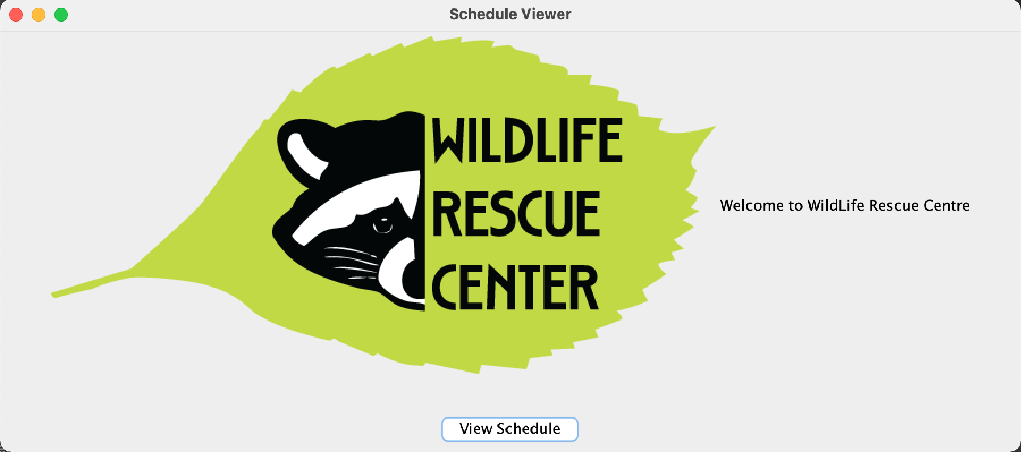
It all Starts with G.U.I. (Front End)
Notes:
This Java code creates a GUI application called "WildlifeScheduleGenerator" that allows users to view a schedule of tasks for a wildlife rescue center .The application has a main class, WildlifeScheduleGenerator, which extends the JFrame class. In the constructor for WildlifeScheduleGenerator, a new JFrame object is created, and several components are added to it. The main frame contains two panels, one at the top and one at the bottom. The top panel displays a logo for the wildlife rescue center, and the bottom panel contains a button labeled "View Schedule."
The ScheduleButton class implements the ActionListener interface and handles the button click event. When the user clicks the "View Schedule" button, a new JFrame object is created to display the schedule . The Schedule has : "Time", "Tasks", "Time Spent", and "Time Available". The table is initially populated with values from 0-23 in the "Time" colum

Slide 3
Classes:
Animal can be classified as:
Crepuscular,
Nocturnal, or
Diurnal
Behind the Curtains (Back End)
Thus, each of the Five Animals (Porcupine, Coyote, fox, BEaver, Raccoon) in the rescue centre can be fed with respect to their Activity Class
Notes:
Each of the Animals, for instance Porcupine, Coyote, etc, inherits from an Activity Class. The Activity Class inherits from the Animal Class. Animal class will be used to store information about all the animals rescued b. The class has several attributes, including ID (unique identification number for each animal), NAME , SPECIES (species of the animal), cleaningDuration (time required to clean the animal's cage), preparingDuration (time required to prepare food for the animal), feedingDuration (time required to feed the animal), CLEANMAXWINDOW (max window to clean animal's cage), feedMaxWindow (max window to feed animal), feedStartHour (start hour for feeding task), CLEANSTARTHOUR (start hour for cleaning task - same for all animals), and orphanedStatus (true if the animal is orphaned, false otherwise).

Slide 4
What about the Schedule?
The Classes:
Schedule
Task
Treatment
IllegalScheduleChange
Can HElp!
(Back End) Continued..
ArrayList include :
1- medical tasks
2- Animals
3- treatments
4-ArrayList of ArrayLists to represent the schedule for each hour of the day
Notes:
//The class Schedule reads the different animals in the shelter from the database and stores them in an ArrayList of animals.
This is a Java program that generates schedules for medical and general tasks for animals in a zoo. The program uses a MySQL database to store information about the tasks and animals. The Schedule class connects to the database and generates the schedule by storing tasks and treatments in ArrayLists.
The Schedule class has six ArrayLists to store tasks, sorted tasks, animals, treatments, and schedule. Sorted tasks are tasks sorted by maximum window, while tasks are tasks stored in the order they appear in the database. Animals are stored in the order of their animal ID. Treatments are sorted by the maximum window of the according task. The schedule ArrayList has nested ArrayLists to store treatments sorted by the start hour and maximum window.
Overall, this program is designed to generate schedules for tasks in a zoo. It connects to a MySQL database to store information about tasks and animals and uses ArrayLists to store and sort the tasks and treatments. The program is flexible and can accommodate new tasks and animals by simply updating the MySQL database.

